Slide 1

PROGRESS REPORT
Closed-Loop Neuroadaptive AR Platform for Scrolling
RICARDO MONRREAL POOL

Slide 2
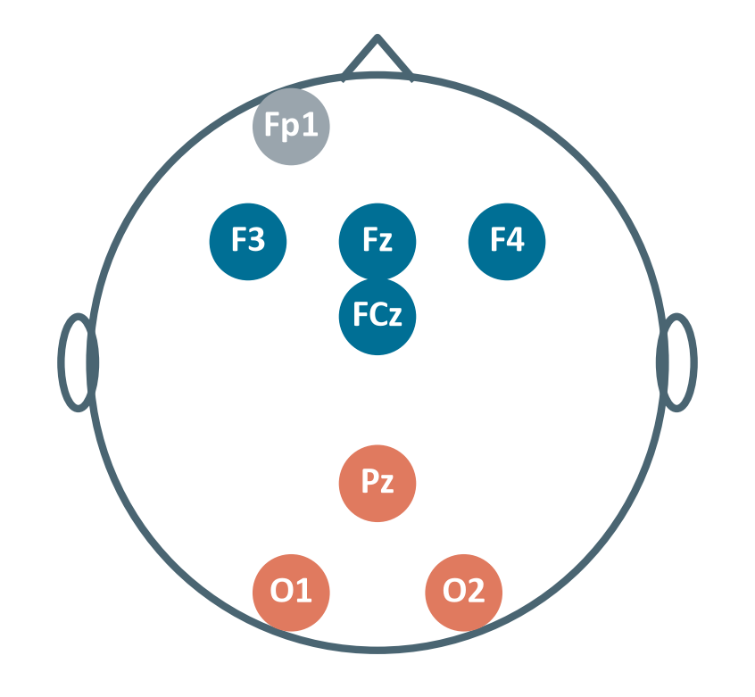

Scope & Framework
We measure the cognitive cost of scrolling
θ ↑
Tonic theta → Fatigue
Fz · FCz · F3 · F4
α ↑
Periodic alpha → Disengagement
Pz · O1 · O2
θ ↓
NoGo theta → Loss of inhibitory control
Fz · FCz · phasic, after NoGo
Fp1
Blinks → Artifact veto
Fp1
Out of scope: dopamine · VTA / striatum are unreachable by scalp EEG

Slide 3
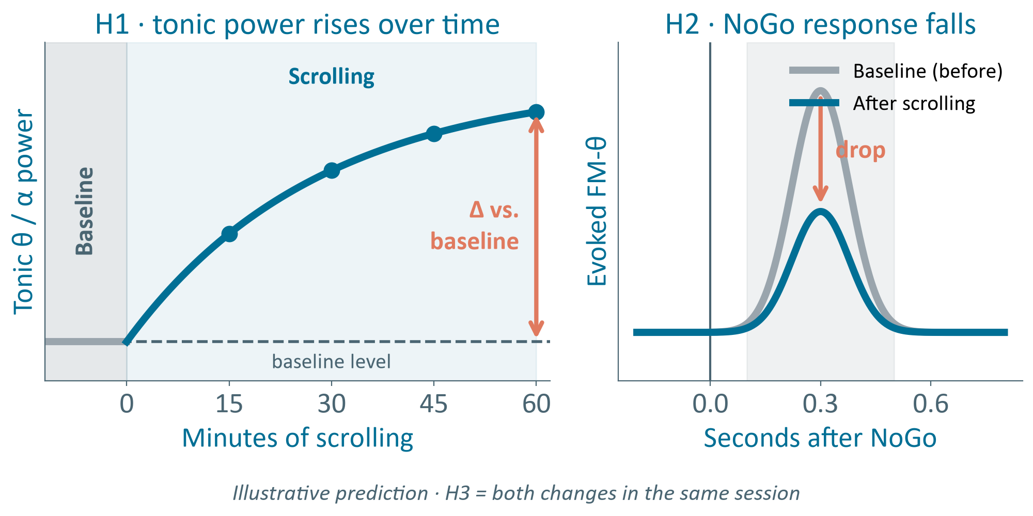
Hypotheses
The original time-based model
H1
Tonic θ / α ↑ more with scrolling than with a documentary
Literature ✓ · datasets partial
H2
NoGo FM-θ ↓ and commission errors ↑ after scrolling
Pending · own Go/NoGo
H3
Both at once: tonic ↑ / phasic ↓
Precedent: Arnau 2021
Source: Arnau, Brümmer, Liegel & Wascher (2021), Psychophysiology, 58(6), e13805

Slide 4
Theoretical Grounding
NoGo errors ↑
45 min smartphone vs. documentary
Jacquet 2023 · behavior, no EEG
g = 1.03
Theta ↑ with fatigue
Tran 2020 · meta-analysis
H2
H1
g = 0.85
Alpha ↑ with fatigue
Tran 2020 · meta-analysis
H1
~1 h
Alpha peaks, theta keeps rising
Wascher 2014
Tonic ↑ · Phasic ↓
Direct precedent of H3
Arnau 2021 · Yu 2022
H2
H3
Effect size scale (Hedges' g)
α 0.85
θ 1.03
small
medium
large
0.2
0.5
0.8
Both effects are large (≥ 0.8)
Requires ≥ 30–60 min · demanding task · never tested with EEG + NoGo during short-video scrolling
Sources: Tran et al. (2020), Psychophysiology · Wascher et al. (2014), Biol. Psychol. · Arnau et al. (2021), Psychophysiology · Yu et al. (2022), Sci. Rep. · Jacquet et al. (2023), Sci. Rep.

Slide 5
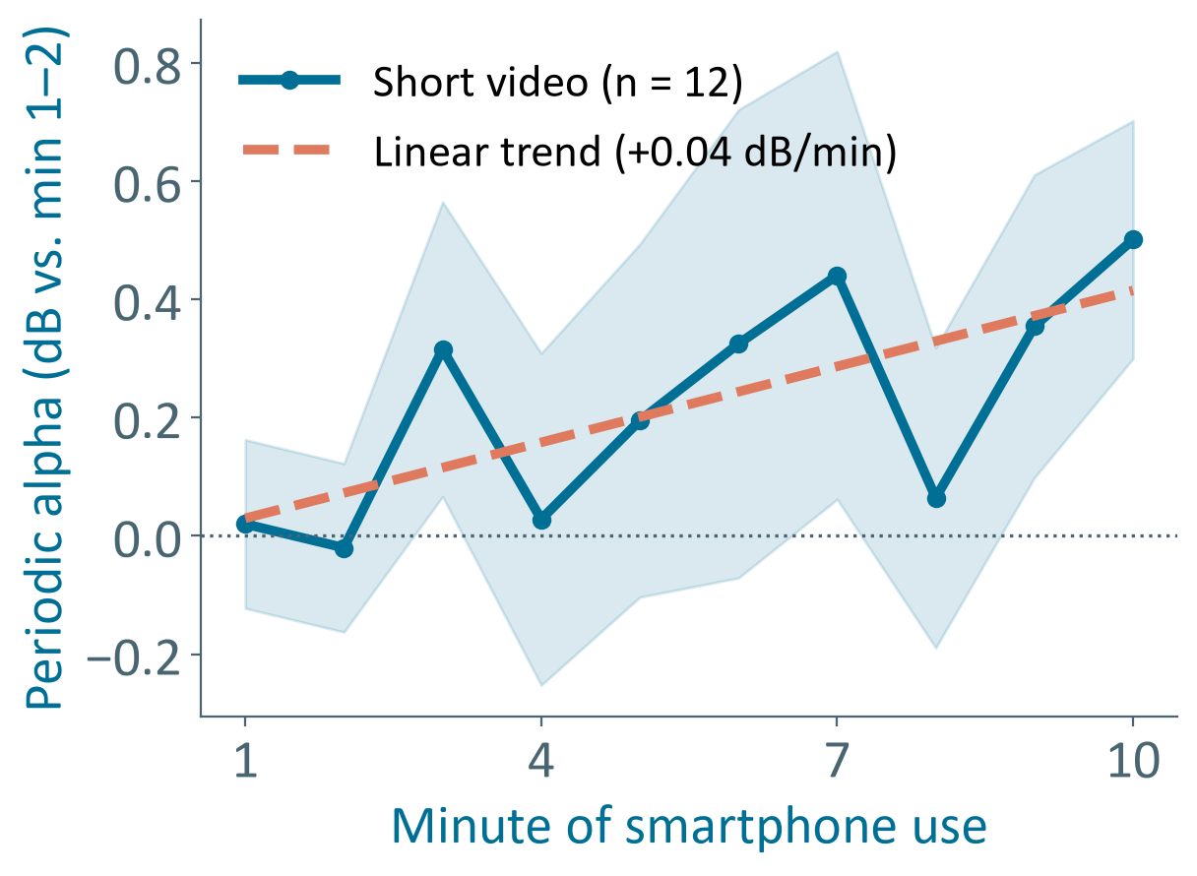
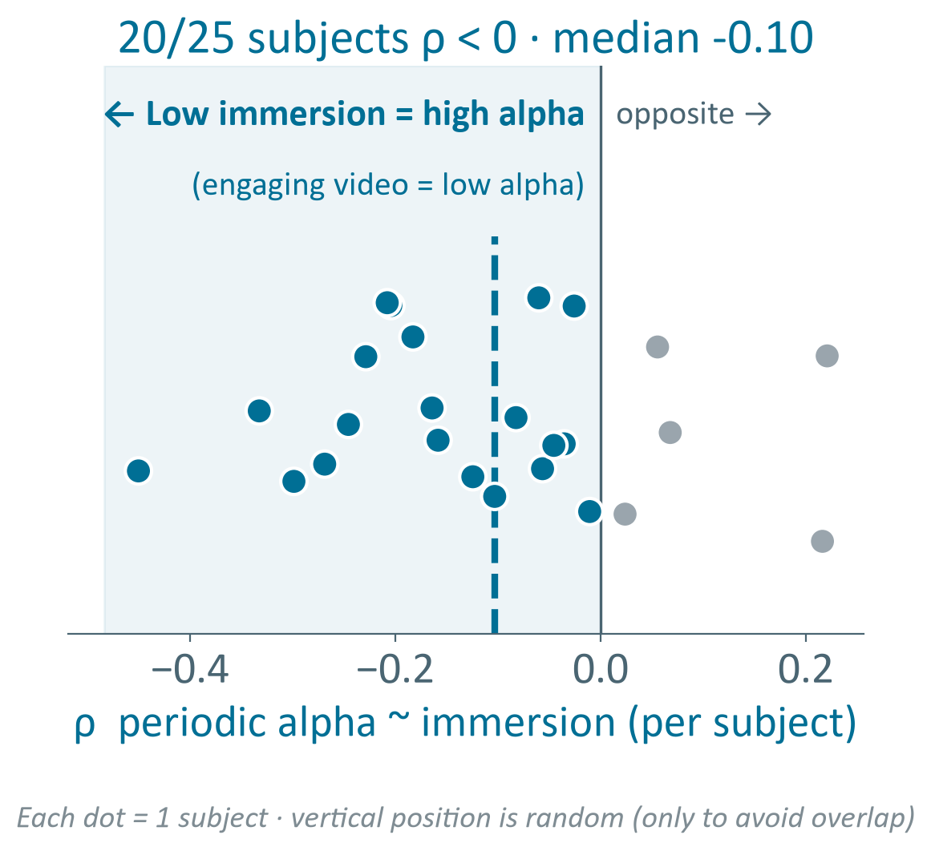
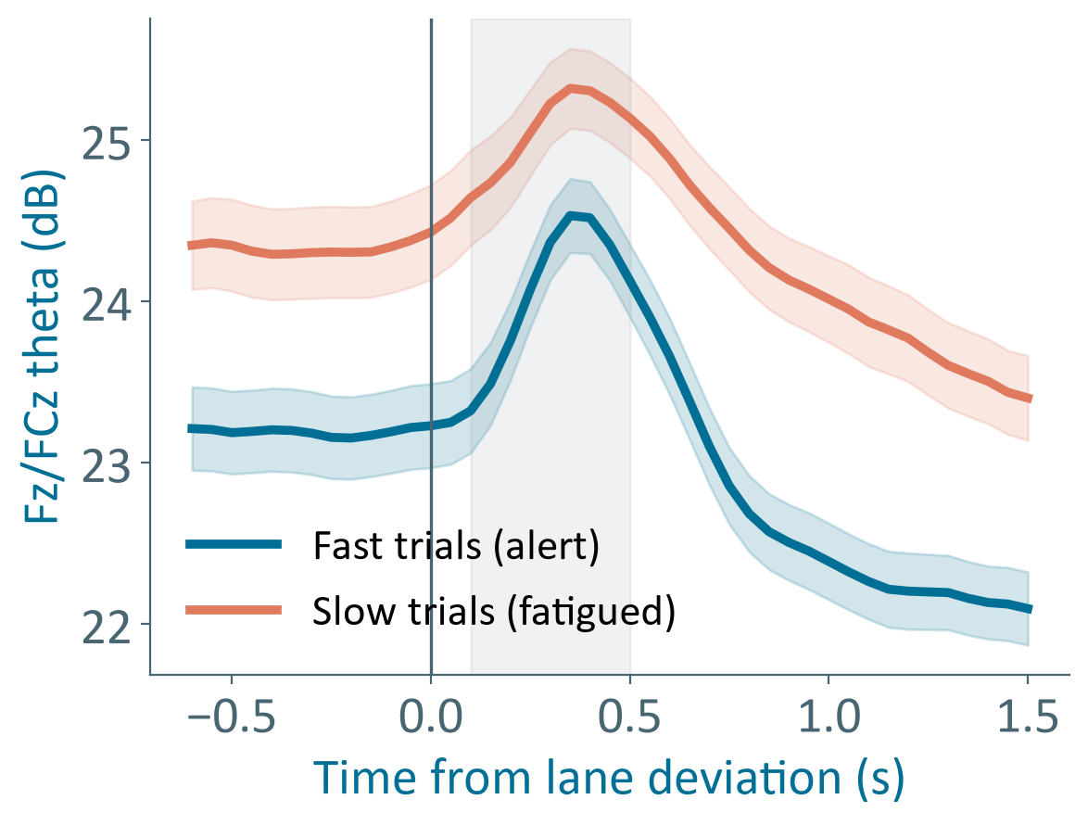
Practical Validation
ds007537 · smartphone · 10 min
EEG-SVRec · short video · ≤ 30 min
Cao 2019 · driving · 60–90 min
Alpha ↑ +0.43 dB
Immersion ↑ → alpha ↓
Tonic θ ↑ → slow RT
Short video · 10/12 subjects
20/25 subjects
27/27 · phasic preserved
Sources: Mishra et al. (2026), OpenNeuro ds007537 · Zhang et al. (2024), EEG-SVRec, SIGIR '24 · Cao et al. (2019), Scientific Data, 6, 19

Slide 6







Why the Datasets Could Not Confirm It
ds007537
EEG-SVRec
Cao 2019
My study
Duration ≥ 30 min
10 min
≤ 30 min
60–90 min
45–60 min
NoGo test
free use
passive
lane deviation
in-feed + pre/post
Control condition
fixed order
fixed order
none
documentary
Fatigue anchor
none
immersion only
RT, lapses
KSS + RT
Scrolling paradigm
smartphone
short video
driving
short video
To my knowledge, no public dataset has all five
Sources: Mishra et al. (2026), OpenNeuro ds007537 · Zhang et al. (2024), EEG-SVRec, SIGIR '24 · Cao et al. (2019), Scientific Data, 6, 19

Slide 7

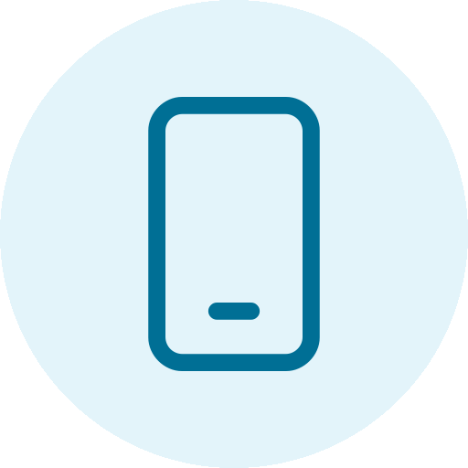


Experimental Plan
Baseline
1 min
Go/NoGo
pre · 3 min
Scrolling | documentary
45–60 min · in-feed NoGo
Go/NoGo
post · 3 min
Self-report
KSS · RT
Simulation first
LSL replay of recorded EEG
Tests features + latency
AURA · 8 channels
Frontal theta
Fz · FCz · F3 · F4
Posterior alpha
Pz · O1 · O2
Blinks
Fp1
EEG file
LSL replay
Pipeline
AR loop

Slide 8
Gantt Diagram
Phase / Process
W1
W2
W3
W4
W5
W6
W7
W8
W9
W10
W11
Phase 1
Software & hardware familiarization
Phase 1
Ideation, prototyping & asset mapping
Phase 2
Documentary research (feedback)
Phase 2
Dataset analysis & data exploration
Phase 3
LSL simulation
Phase 3
Subject testing (pilot)
Phase 3
Results collection & interpretation
Phase 4
Mentor feedback · choose path
Phase 4
AR environment (based on H1–H3 results)
Phase 4
Research synthesis (literature + results)
Phase 4
Final report & documentation
Completed (W1–W5)
Planned
Mentor checkpoint
11

Slide 9
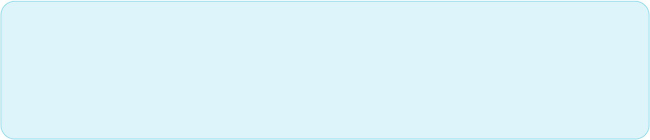

LSL simulation with the public datasets
1
Own experiment: EEG data from subjects
2
Next Steps
Validate H1, H2 and H3
3

Slide 10
References
Arnau, S., Brümmer, T., Liegel, N., & Wascher, E. (2021). Inverse effects of time-on-task in task-related and task-unrelated theta activity. Psychophysiology, 58(6), e13805. https://doi.org/10.1111/psyp.13805
Benwell, C. S. Y., et al. (2019). Frequency and power of human alpha oscillations drift systematically with time-on-task. NeuroImage, 192, 101–114. https://doi.org/10.1016/j.neuroimage.2019.02.067
Cao, Z., Chuang, C.-H., King, J.-K., & Lin, C.-T. (2019). Multi-channel EEG recordings during a sustained-attention driving task. Scientific Data, 6, 19. https://doi.org/10.1038/s41597-019-0027-4
Cavanagh, J. F., & Frank, M. J. (2014). Frontal theta as a mechanism for cognitive control. Trends in Cognitive Sciences, 18(8), 414–421. https://doi.org/10.1016/j.tics.2014.04.012
Desmond, P. A., & Hancock, P. A. (2001). Active and passive fatigue states. In P. A. Hancock & P. A. Desmond (Eds.), Stress, workload, and fatigue (pp. 455–465). Erlbaum.
Fortes, L. S., et al. (2019). Effect of exposure time to smartphone apps on passing decision-making in male soccer athletes. Psychology of Sport and Exercise, 44, 35–41.
Jacquet, T., Lepers, R., Pageaux, B., & Poulin-Charronnat, B. (2023). Acute smartphone use impairs vigilance and inhibition capacities. Scientific Reports, 13, 23046. https://doi.org/10.1038/s41598-023-50354-3
Kato, Y., Endo, H., & Kizuka, T. (2009). Mental fatigue and impaired response processes: Event-related brain potentials in a Go/NoGo task. International Journal of Psychophysiology, 72(2), 204–211.
Marcora, S. M., Staiano, W., & Manning, V. (2009). Mental fatigue impairs physical performance in humans. Journal of Applied Physiology, 106(3), 857–864. https://doi.org/10.1152/japplphysiol.91324.2008
Mishra, P., Gandhi, T. K., & Gandhi, S. R. (2026). A multimodal dataset of EEG, eye-tracking, and physiological signals during naturalistic smartphone interactions. bioRxiv. OpenNeuro ds007537.
Nahum-Shani, I., et al. (2018). Just-in-time adaptive interventions (JITAIs) in mobile health. Annals of Behavioral Medicine, 52(6), 446–462. https://doi.org/10.1007/s12160-016-9830-8
Nguyen, L., et al. (2025). Feeds, feelings, and focus: A systematic review and meta-analysis examining the cognitive and mental health correlates of short-form video use. Psychological Bulletin, 151(9), 1125–1146. https://doi.org/10.1037/bul0000498
Orzikulova, A., et al. (2024). Time2Stop: Adaptive and explainable human-AI loop for smartphone overuse intervention. Proceedings of CHI ’24. ACM.
Sharpe, B. T., & Spooner, R. A. (2025). Dopamine-scrolling: A modern public health challenge requiring urgent attention. Perspectives in Public Health, 145(4), 190–191. https://doi.org/10.1177/17579139251331914
Sharpe, A. T. R., Tyndall, I., Poulus, D. R., Obine, E. A. C., & Sharpe, B. T. (2026). The influence of doomscrolling on mental health: A scoping review. Mental Health and Digital Technologies, 3(3), 290–342.
Tran, Y., Craig, A., Craig, R., Chai, R., & Nguyen, H. (2020). The influence of mental fatigue on brain activity: Evidence from a systematic review with meta-analyses. Psychophysiology, 57(5), e13554. https://doi.org/10.1111/psyp.13554
Wascher, E., et al. (2014). Frontal theta activity reflects distinct aspects of mental fatigue. Biological Psychology, 96, 57–65. https://doi.org/10.1016/j.biopsycho.2013.11.010
Yan, T., Su, C., Xue, W., Hu, Y., & Zhou, H. (2024). Mobile phone short video use negatively impacts attention functions: An EEG study. Frontiers in Human Neuroscience, 18, 1383913. https://doi.org/10.3389/fnhum.2024.1383913
Yu, S., Mückschel, M., & Beste, C. (2022). Superior frontal regions reflect the dynamics of task engagement and theta band-related control processes in time-on-task effects. Scientific Reports, 12, 846. https://doi.org/10.1038/s41598-022-04972-y
Zhang, S., et al. (2024). EEG-SVRec: An EEG dataset with user multidimensional affective engagement labels in short video recommendation. Proceedings of SIGIR ’24. https://arxiv.org/abs/2404.01008

Slide 11






System Pipeline
1 · Scrolling
swipe + NoGo markers
2 · AURA EEG
8 ch · LSL stream
3 · Preprocessing
filter · artifacts · blinks
closed loop
6 · AR feedback
cue → friction → pause
5 · Individual model
per-user calibration → state
4 · Features
θ · α periodic · 1/f · 2–4 s
BIDS storage
Session dashboard
Offline LSL simulator

Slide 12


Robust to Negative Results
H1 ✓ tonic fatigue
H1 ✗ no tonic fatigue
Safeguards
H2 ✓
Full ladder
cue → friction → pause
Friction
in-feed NoGo errors
OSF preregistration
TOST / Bayes factors
Individual calibration
H2 ✗
Restorative pause
tonic markers only
Awareness cue
alpha + behavior · publishable null
Hybrid EEG + behavior
Eyes-closed alpha demo
Hypotheses decide which signal drives the AR, not whether it works

Slide 13



Objectives
Closed-loop EEG + AR platform that detects fatigue and loss of inhibitory control during short-video scrolling
AR intervention
Just-in-time · EEG vs. timer
Offline validation
3 public datasets
Own protocol
Scrolling vs. documentary + Go/NoGo
Real-time pipeline
LSL · features · individual model
Data & docs
BIDS telemetry · standards

Slide 14






The Problem
Dopamine scrolling affects every generation, and hits the youngest hardest.
Teenagers
Generation Z
Millennials
Generation X
Baby Boomers
13–17 y/o
21%
53%
46%
27–33%
<15%
severe social media and short-form video addiction
acute dependency or incapacity to stop scrolling
chronic attentional dysregulation, compulsive use
compulsive consumption hurting daily productivity
hooked into dopamine loops by short videos
Negative outcomes: mental distraction, degraded social interaction, sleep disruption, and increased risk of anxiety and depression.
Nguyen, L., et al. (2025). Feeds, feelings, and focus: A systematic review and meta-analysis examining the cognitive and mental health correlates of short-form video use.
2

Slide 15







Rationale
Market Overview
  Digital interfaces exploit variable reward
  The global digital mental health market is
schedules and infinite scroll to hijack
projected to reach $45 billion USD by 2030,
dopaminergic pathways, the result is a
  This demand is further supported by
passive, hypnotic state with diminished
behavioral data showing that 83% of Gen Z
prefrontal cortex oversight.
users acknowledge having an unhealthy
  The constant media multitasking and
relationship with their smartphones due to
immediate gratification of entertainment-
compulsive short-form content consumption.
seeking may influence user’s cognitive
control of attention.
Sources: Neural correlates of short-video application addiction and adolescents’ executive functions (2024).
Sources: Generation Z’s Smartphone and Social Media Usage: A Survey. (2019)..

Slide 16








Proposed Solution
01
02
03
Immersive Detection Engine
Dynamic Environmental Modulation
Active Inhibitory Engagement
Tracks behavioral markers and gaze patterns to identify the transition into the dopamine- scrolling trance.
Alters the virtual environment’s visual and auditory parameters to restore inhibitory control.
Prompts conscious user agency through deliberate interaction tasks that demand intentional effort, strengthening prefrontal inhibitory control.
Closed-loop architecture: Detection → Modulation → Engagement
6

Slide 17






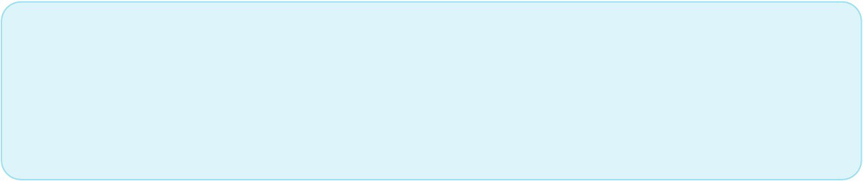
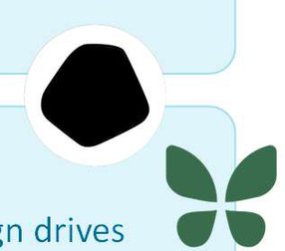
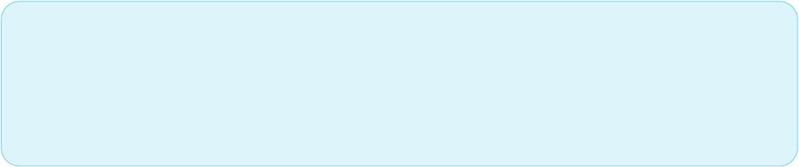
Competitor Analysis
Inmersive VR Therapy (PsyTech VR, Psious/Amelia Virtual Care)
State of the Art
Strength: virtual enviroments. Weakness: aimed to substance addiction; are guided by a therapist.
  Scoping reviews show passive media
consumption degrades cognitive
flexibility and worsens emotional
App Blockers (Freedom, Opal)
exhaustion.
Strength: strong hard-blocking. Weakness: punitive design drives churn and ignores underlying dopamine-seeking triggers.
  Closed-loop physiological monitoring
and standalone VR headsets enable
high-fidelity detection of attentional
fatigue.
Proposed Solution Advantage
  Real-time sensory redirection shifts
Combines immersive VR presence with closed-loop neuroadaptive triggers, aimed to self-regulate impulse dysregulation and help to restore inhibitory control.
the field from static app blocking to
active neurobehavioral rehabilitation.
5

Slide 18

INNOVATION FACTOR
A closed-loop therapeutic intervention model within immersive VR.
The first market solution combining real-time EEG signals with immersive VR to self-regulate dopamine scrolling, featuring a telemetry-driven neuroadaptive ecosystem with dynamic environmental shifts tailored for compulsive digital behaviors rather than traditional substance therapies or static apps which forces to stop the use of digital devices.
9

Slide 19




Target Market
PRIMARY SEGMENT
SECONDARY SEGMENT
18–35
years old
Educational institutions and clinical psychology practices specializing in behavioral addiction and executive function training.
Generation Z and Millennials experiencing high daily screen dependency and attentional fatigue.
10

Slide 20








Technologies Used
Game Engine & VR Framework
Backend & Analytics
Unity (C#) with OpenXR for cross- platform.
Python (Flask, Pandas) for processing telemetry data and session metrics.
Version Control & CI/CD
Hardware Target
Git, GitHub, and automated build pipelines.
VR Headset and AURA device.
8

Slide 21




Development Plan
1
2
3
4
Phase 1
Phase 2
Phase 3
Phase 4
  Software and hardware familiarization
  Conceptual ideation, prototyping, and asset mapping
  Development and building of the core Virtual Reality scene and UI components in Unity
  Initial signal acquisition testing and validation
  End-to-end integration testing between the VR environment, Python processing pipeline, and Data Management System.
  Preparation and execution of live, real-time interactive demonstrations of the neuroadaptive platform.
7

Slide 22
Gantt Diagram
Phase / Process
W1
W2
W3
W4
W5
W6
W7
W8
W9
W10
W11
Phase 1
Software & hardware
familiarization
Phase 1
Ideation, prototyping & asset
mapping
Phase 2
VR scene & UI development in Unity
Phase 2
Initial signal acquisition testing &
validation
Phase 3
VR environment – Python pipeline
integration
Phase 3
Data Management System
integration & end-to-end testing
Phase 4
Live demonstration preparation
Phase 4
Final report & Documentation
Core development phases (2 & 3)
Setup & delivery phases (1 & 4)
11

